Slide 1
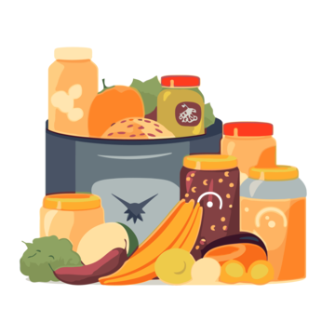
Pantry Pal
By: Team Blue

Slide 2
Name: Rick Roberson
Location: San Francisco, California
Age: 35 years old
Tech experience level: Quite Advanced (Grew up using technological devices and is very accustomed to them)
Works from home, occasionally goes to his office for meetings but usually stays home.
Goals:
Reduce food waste
Stop buying duplicate pantry items
Stay within monthly grocery budget
Keep kitchen organized
Challenges:
Forgetting what he already has at home
Expired food in the back of cabinets
Disorganized pantry and fridge
No system for tracking quantities
Tools They Currently Use:
Notes app for grocery lists
Paper list on fridge
Excel occasionally for budgeting
Grocery store apps
Calendar reminders
Their Success Is Measured By:
Staying under grocery budget
Throwing away less expired food
Fewer last-minute grocery runs
Motivations:
Save money
Reduce stress
Feel more organized
Live more sustainably
Preferred Method of Communication:
Mobile apps
Email reminders
Simple dashboards

Slide 3
